Slide 1

Inside Out
THE ULTIMATE WEB APPLICATION FOR
MANAGING YOUR BUSINESS

Slide 2

1. Our Welcome Message
2. Project Phases
2.1. Forming the team
2.2. Initiating the project
TABLE OF CONTENTS
2.3. Developing the prototype and documenting the use case scenarios
2.4. Modelling the database
2.5. Formal Inspection Phase
2.6. Modelling the web application
2.7. Implementing the application
2.8. Testing the application

Slide 3
1.Our Welcome Message
Our project represents a vision of the ultimate web application for improving your company's time and resource management. The main objective of this project is providing an online platform developed using the latest technology in the area of web design and back-end programming which hosts a variety of management tools. These tools are displayed to our clients using an elegant, clean-looking interface on both desktop and mobile, while our server processes and handles the requests of a large number of users simultaneously in a matter of seconds.

Slide 4

2. Project Phases

Slide 5
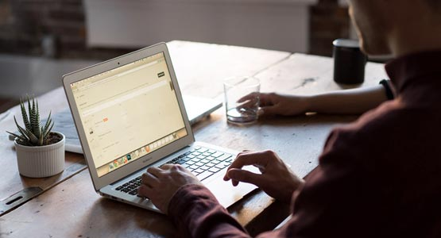
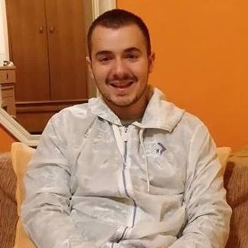
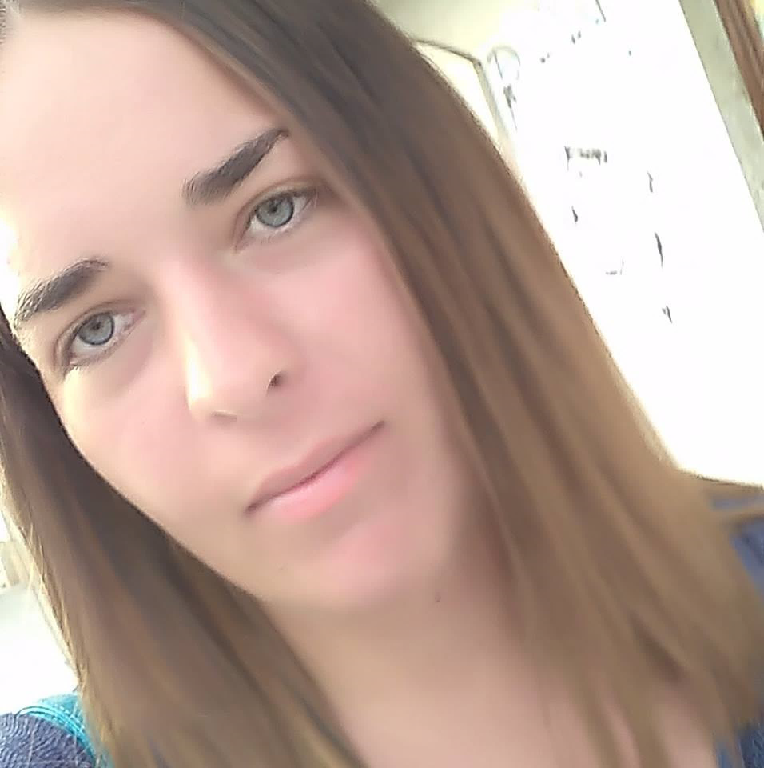
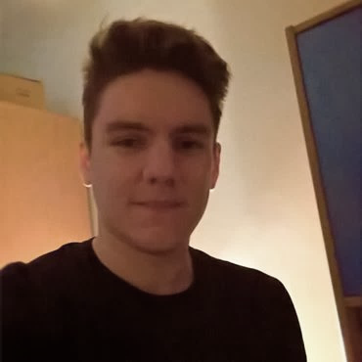
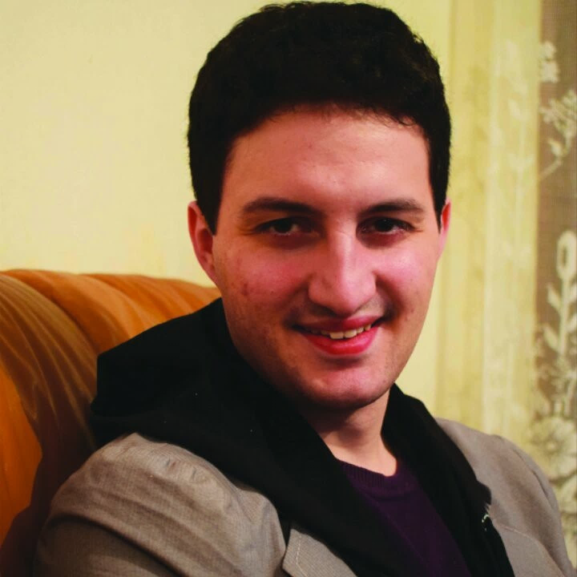
2.1. Forming the team
- The team was founded during the winter holidays of 2018 on the initiative of Aleksa Marušić. We first talked through messages and later on had the opportunity to get together on the 30th of January. After this initial meeting, Nikola was chosen as the team leader as he had had the most experience in larger projects.
Nikola Nedeljković
Marija Kostić
Stefan Milanović
Aleksa Marušić
SOFTWARE ENGINEER
SOFTWARE ENGINEER
SOFTWARE ENGINEER
SOFTWARE ENGINEER
Third year student of Software Engineering at the University of Belgrade.
Third year student of Software Engineering at the University of Belgrade.
Third year student of Software Engineering at the University of Belgrade.
Third year student of Software Engineering at the University of Belgrade.

Slide 6
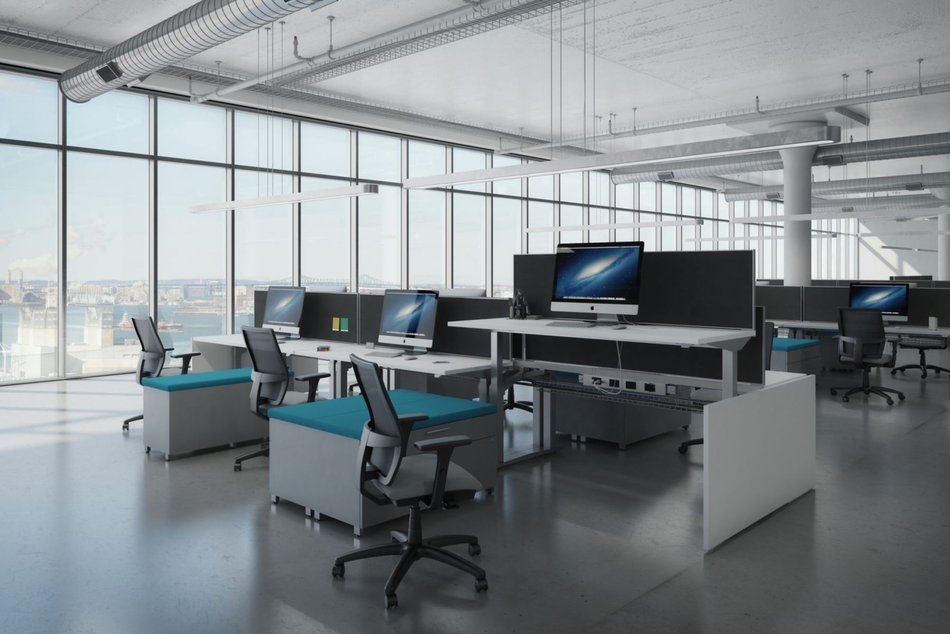
- Lead members during this phase: The entire team
- Number of meetings: 2
2.2. Initiating the project
Meeting 1– Nikola Nedeljković, Stefan Milanović - Conceiving the base of the project
Meeting 2 – The entire team – Reviewing the written project summary, laying out ideas for further development
- Project Summary written by: Stefan Milanović

Slide 7
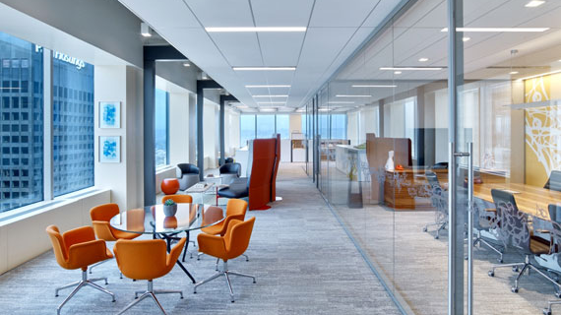
- Lead members during this phase: The entire team
- Number of meetings: 1 (prototype meeting) + 1 (UCS meeting)
Prototype
Lead members: Marija Kostić, Aleksa Marušić
Marija Kostić – Guest pages, Administrator pages, part of Director pages
2.3. Developing the prototype and documenting the use case scenarios
Aleksa Marušić – Employee pages, Manager pages, part of Director pages
Used technology: HTML, CSS, JavaScript, JQuery
Use Case Scenarios
Lead members: Stefan Milanović, Nikola Nedeljković
Stefan Milanović – Use Case Scenarios 1-13
Nikola Nedeljković – Use Case Scenarios 14-23

Slide 8

- Lead members during this phase: Nikola Nedeljković
- Number of meetings: 1
2.4. Modelling the database
Meeting 1– The entire team – Reviewing the database model
- Used technology: Erwin Data Modeller
- Database modelled by: Nikola Nedeljković
- Documentation written by: Nikola Nedeljković

Slide 9

- Lead members during this phase: Marija Kostić, Stefan Milanović, Aleksa Marušić
- Reviewed team: UdonSoba
- Number of meetings: 2
2.5. Formal Inspection Phase
Meeting 1– Overview meeting
Meeting 2– Formal Review meeting
- Moderator: Stefan Milanović
- Recorder: Marija Kostić
- Inspectors: Marija Kostić, Stefan Milanović, Aleksa Marušić

Slide 10
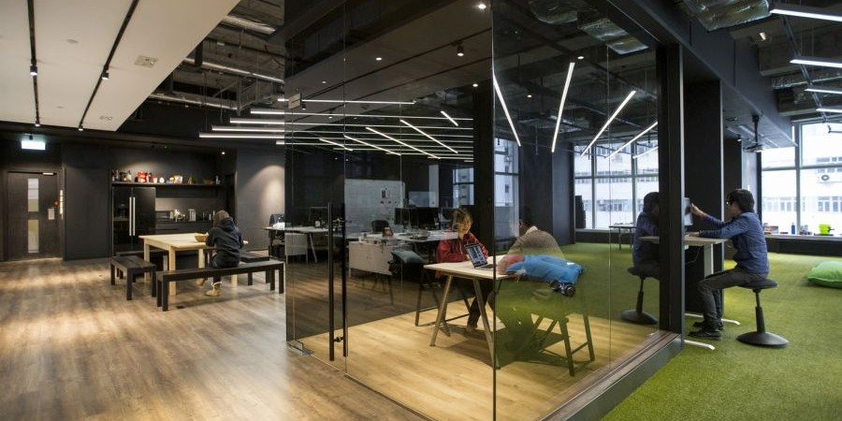
- Lead members during this phase: The entire team
- Number of meetings: 1 (online meeting)
2.6. Modelling the web application
Meeting 1– The entire team – Splitting the work into 4 groups
- Nikola Nedeljković: WAE assistance, 5 Use Case Scenarios
- Marija Kostić: WAE main member, 1 Use Case Scenario
- Stefan Milanović: 8 Use Case Scenarios
- Aleksa Marušić: 9 Use Case Scenarios
- Used technology: StarUML

Slide 11
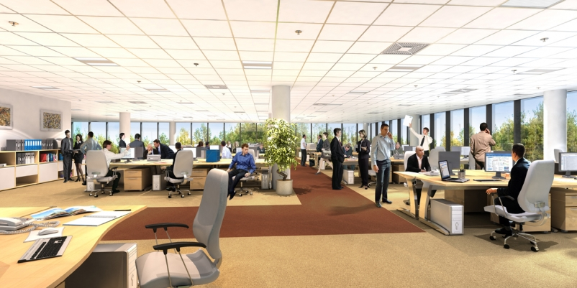
- Lead members during this phase: The entire team
- Implementation was split based on Use Case Scenarios
- How the work was divided (numbers represent UCS’s) :
Nikola Nedeljković: 1, 4, 16, 17, 18, 20, 23
2.7. Implementing the application
- Marija Kostić: 14, 15, 19, 21, 22
- Stefan Milanović: 2, 3, 6, 7, 12, 13
- Aleksa Marušić: 5, 8, 9, 10, 11
- Used technology: HTML, CSS, JavaScript, JQuery, PHP, MySQL Server

Slide 12
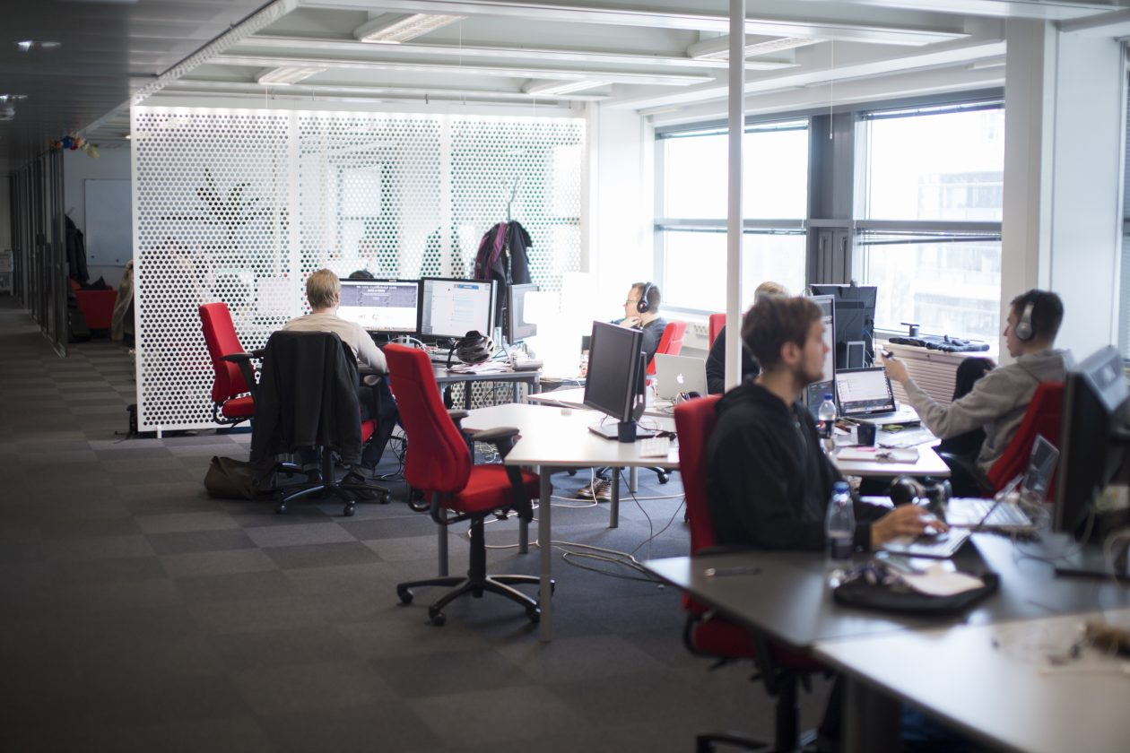
- Lead members during this phase: The entire team
2.8. Testing the application
- Bug fixes
- Manual testing

Slide 13

Questions?

